Slide 1
mini_analysis
IBK KW Filterability Analysis and Prediction

Slide 2
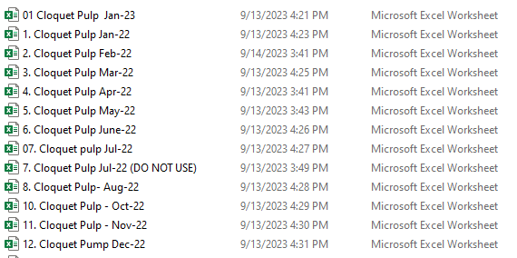
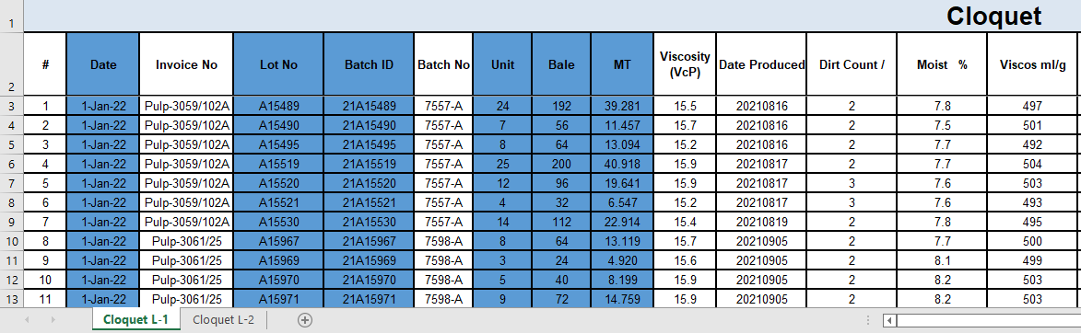
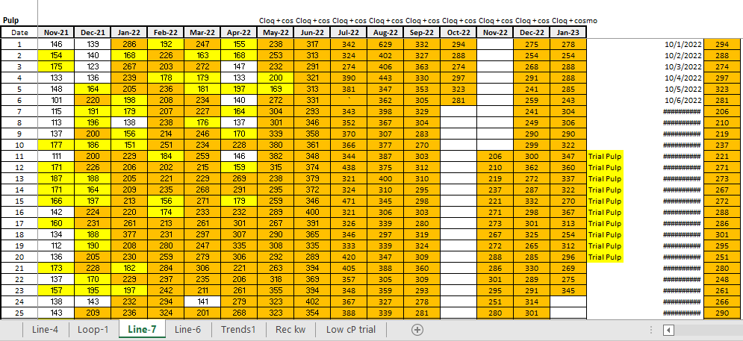
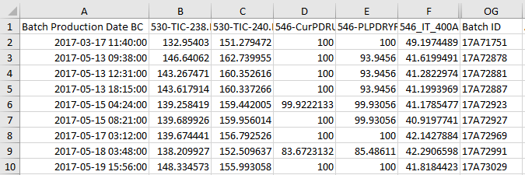
… selected six (6) highlighted variables
1. join by Batch ID
… KW, Loop 1_2
… Batch Prod Date BC, BC variables, Batch ID
2. join by LOOP

Slide 3
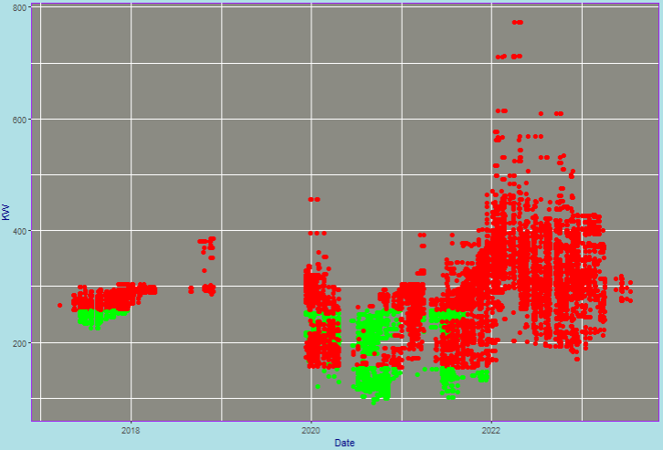
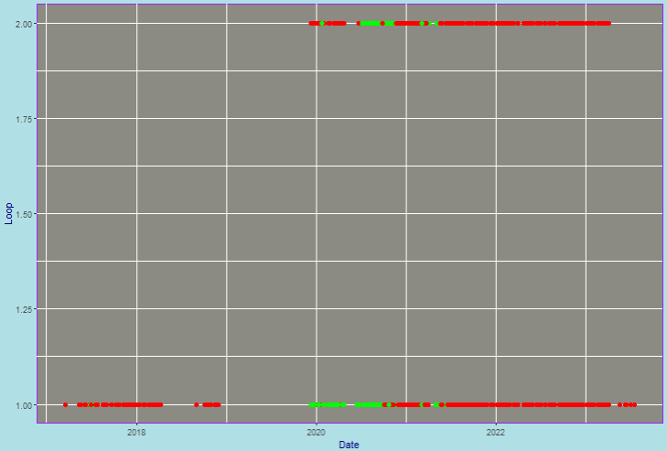
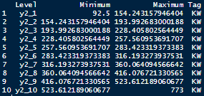
Data for modelling (March 2017 – July 2023)
Target variables:
Loop and Daily IBR KW Filterability
< 257.6 KW = “GOOD”
< 154.3 KW = “GOOD”
Loop 1:
Loop 2:

Slide 4
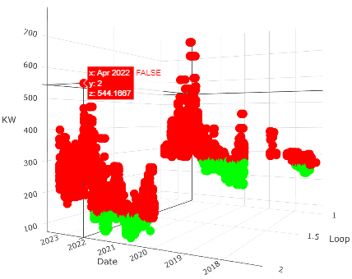

Data for modelling (March 2017 – July 2023)
Target variables:
Loop and Daily IBR KW Filterability
< 257.6 KW = “GOOD”
< 154.3 KW = “GOOD”
Loop 1:
Loop 2:

Slide 5
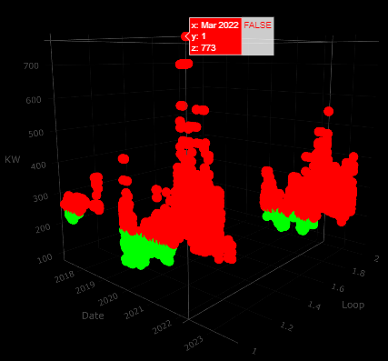
Data for modelling (March 2017 – July 2023)
Target variables:
Loop and Daily IBR KW Filterability
< 257.6 KW = “GOOD”
< 154.3 KW = “GOOD”
Loop 1:
Loop 2:
Total observations: 33162
Total Good = 17.9% (Loop 1: 14.3% | Loop 2: 3.6%)
Total Bad = 82.1% (Loop 1: 54.7% | Loop 2: 27.4%)
Loop 1 Loop 2
Good: 4757 Good: 1194
Bad: 18128 Bad: 9083
Total: 22885 Total: 10277
Good: 20.8% Good: 11.6%
Bad: 79.2% Bad: 88.4%

Slide 6
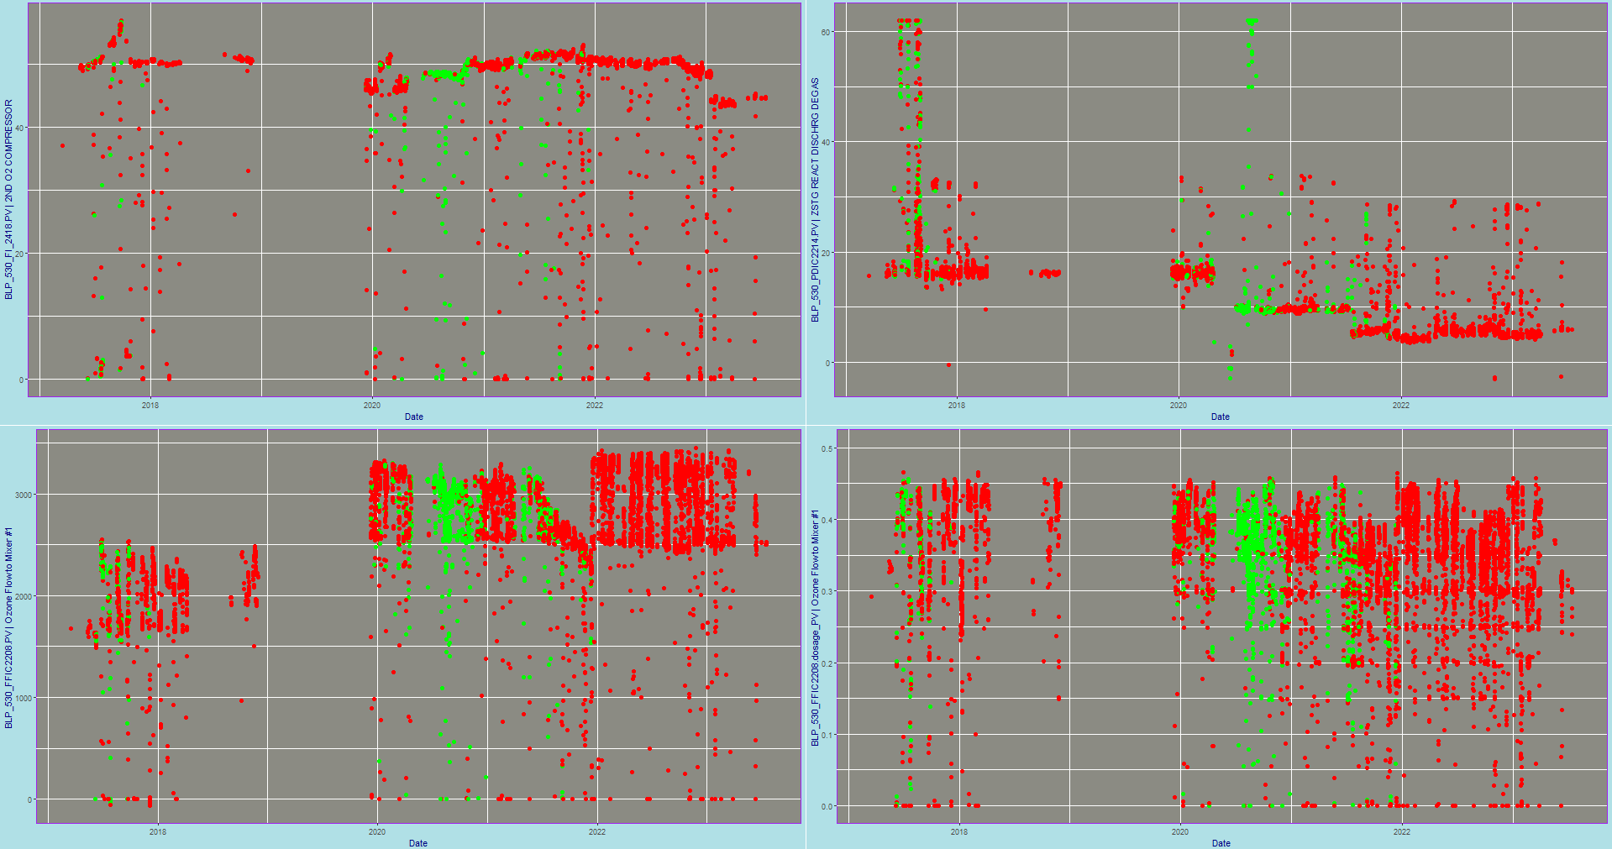
Time Plots

Slide 7

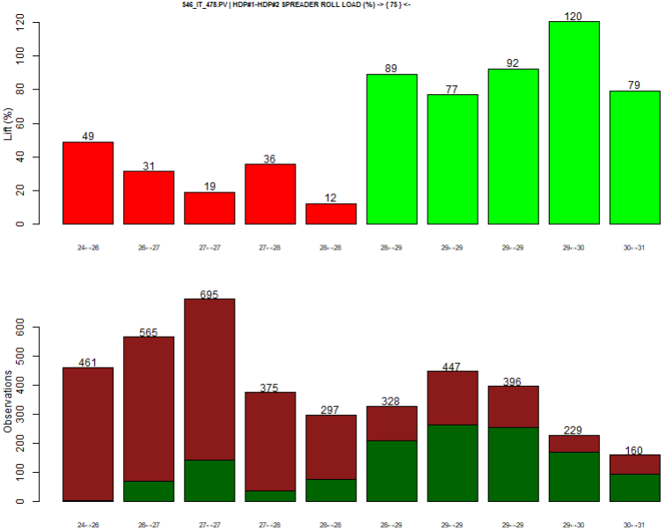
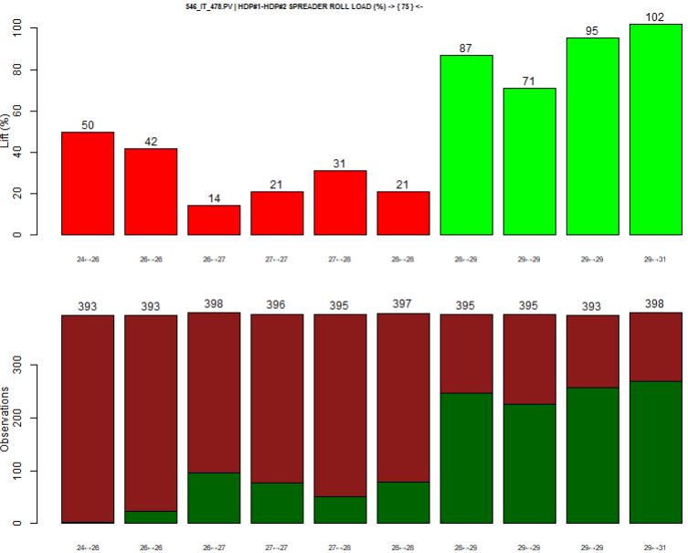
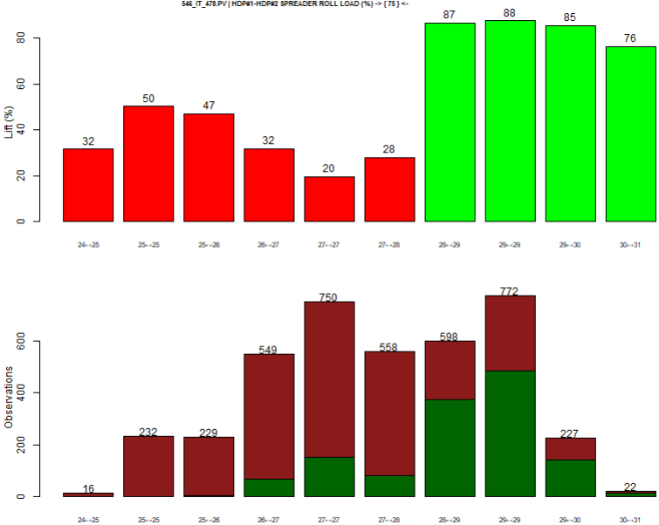
Discretization
Cluster
Frequency
Interval
Fixed
For categorical data

Slide 8
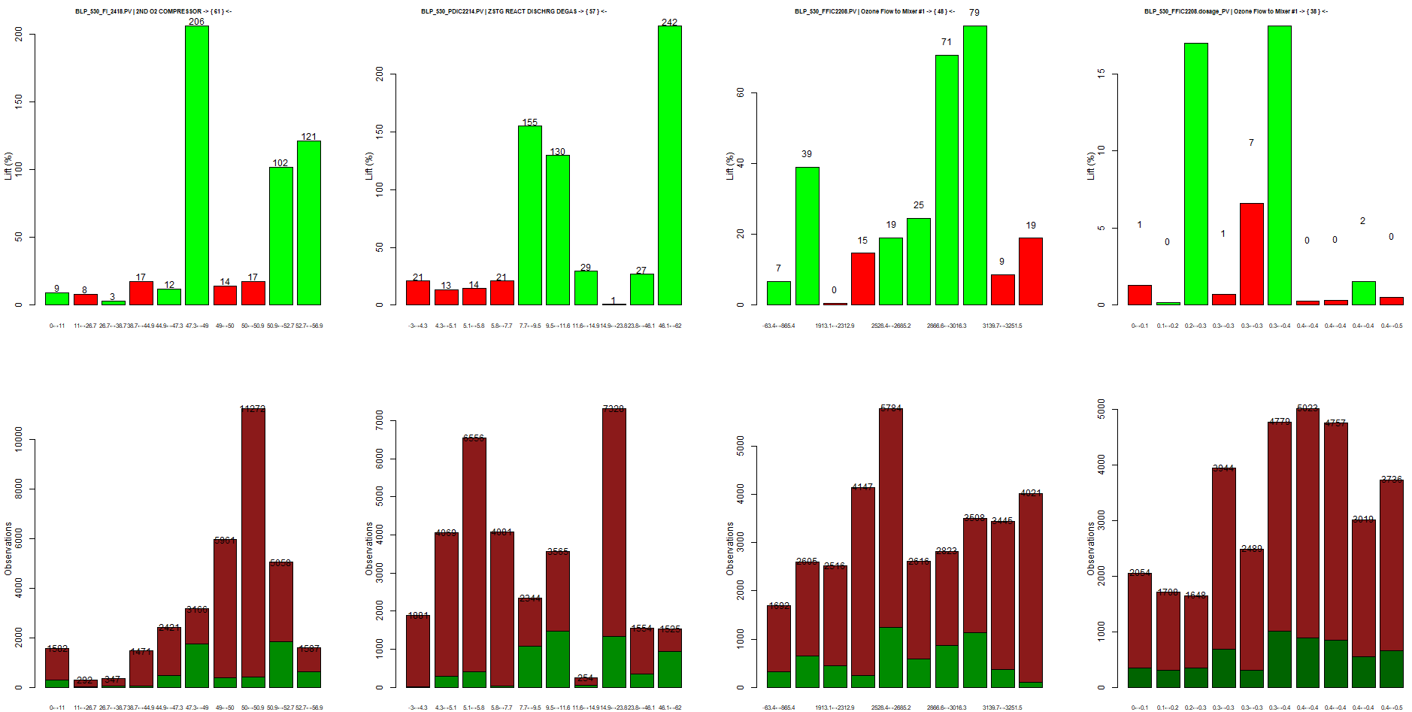
Lifts + Frequencies

Slide 9
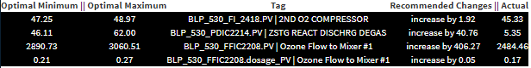
Recommended Settings

Slide 10
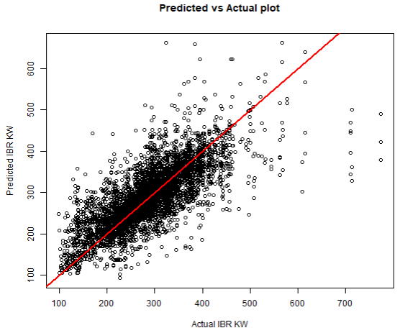
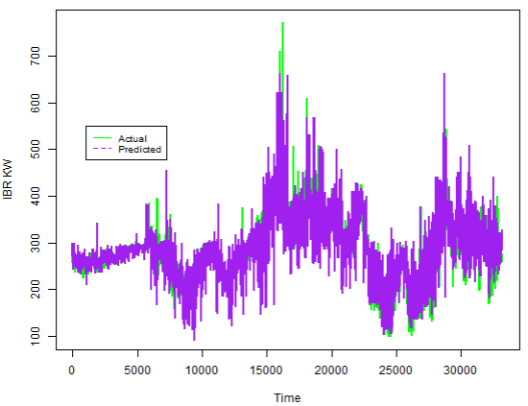
Predicted vs. Actual
Root Mean Square Error: 48.5 Standard Deviation: 73.7 Mean: 286.9 Coefficient of Variation = Standard Deviation / Mean = 25.7%
RMSE
Mean = 16.9% R² = 0.57 Adjusted R² = 0.32
RMSE
Standard Deviation = 65.8% Accuracy = 100 – AVERAGE(100 * (ABS(Prediction – Actual) / Actual)) = 88.03 %

Slide 11
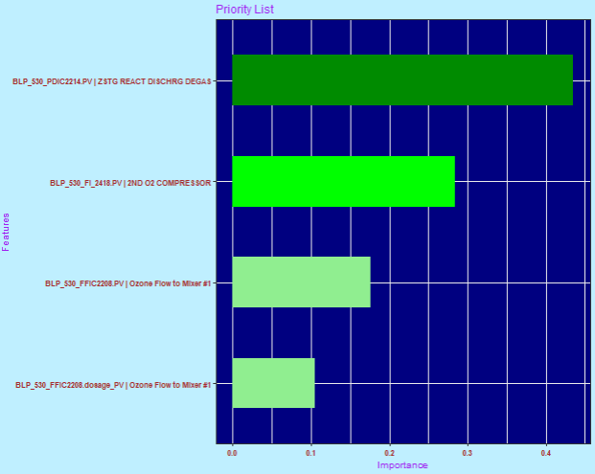
Variable Importance (XGBoost)

Slide 12
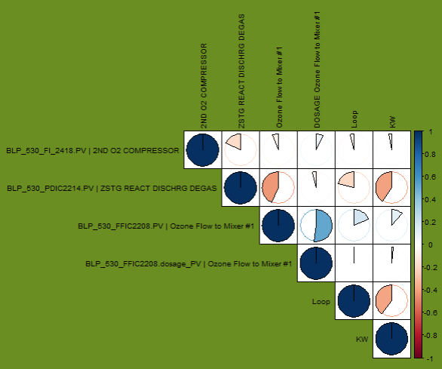
Correlations

Slide 13
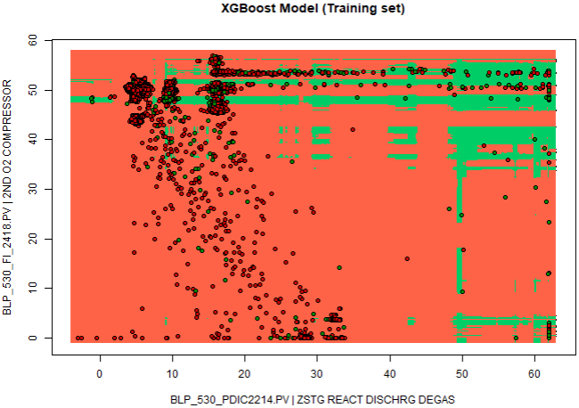
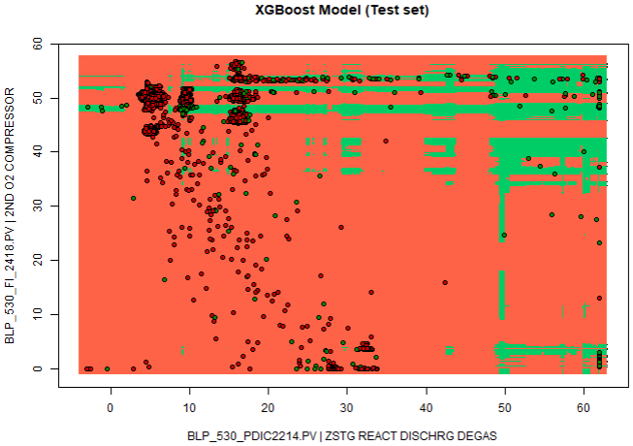
Mind of the Model (2-parameter)
Occam’s razor: Entia non sunt multiplicanda praeter necessitatem, ["Entities must not be multiplied beyond necessity“]
The problem-solving principle that recommends searching for explanations constructed with the smallest possible set of elements.
P4-metric = 76.2%

Slide 14
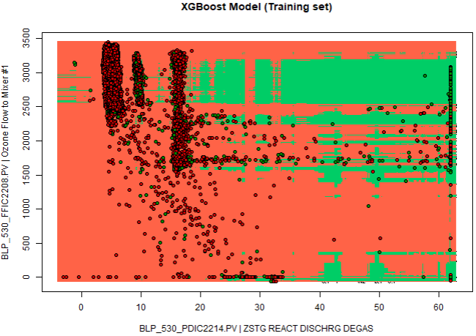
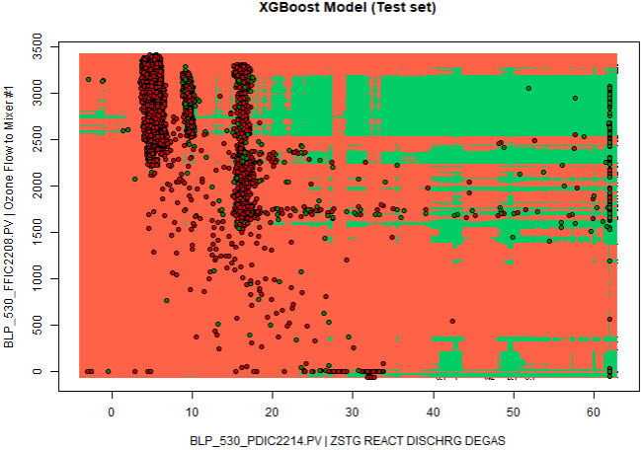
Mind of the Model (2-parameter)
Occam’s razor: Entia non sunt multiplicanda praeter necessitatem, ["Entities must not be multiplied beyond necessity“]
The problem-solving principle that recommends searching for explanations constructed with the smallest possible set of elements.
P4-metric = 60.5%

Slide 15
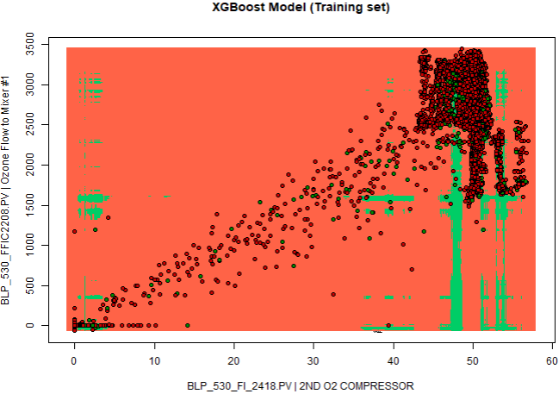
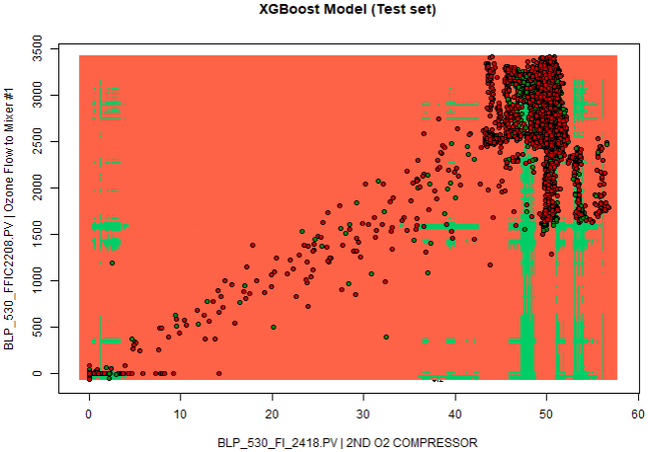
Mind of the Model (2-parameter)
Occam’s razor: Entia non sunt multiplicanda praeter necessitatem, ["Entities must not be multiplied beyond necessity“]
The problem-solving principle that recommends searching for explanations constructed with the smallest possible set of elements.
P4-metric = 70.1%

Slide 16
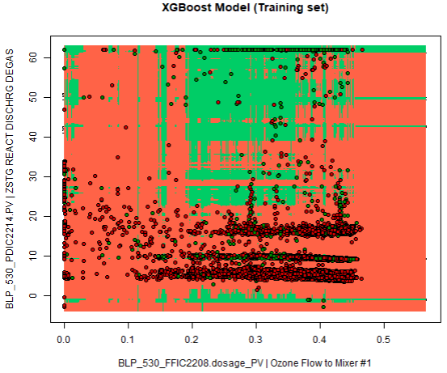
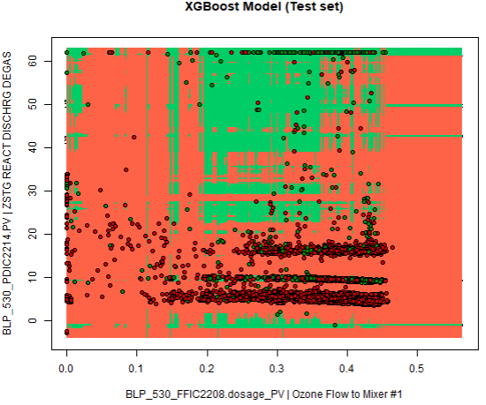
Mind of the Model (2-parameter)
Occam’s razor: Entia non sunt multiplicanda praeter necessitatem, ["Entities must not be multiplied beyond necessity“]
The problem-solving principle that recommends searching for explanations constructed with the smallest possible set of elements.
P4-metric = 61.8%

Slide 17
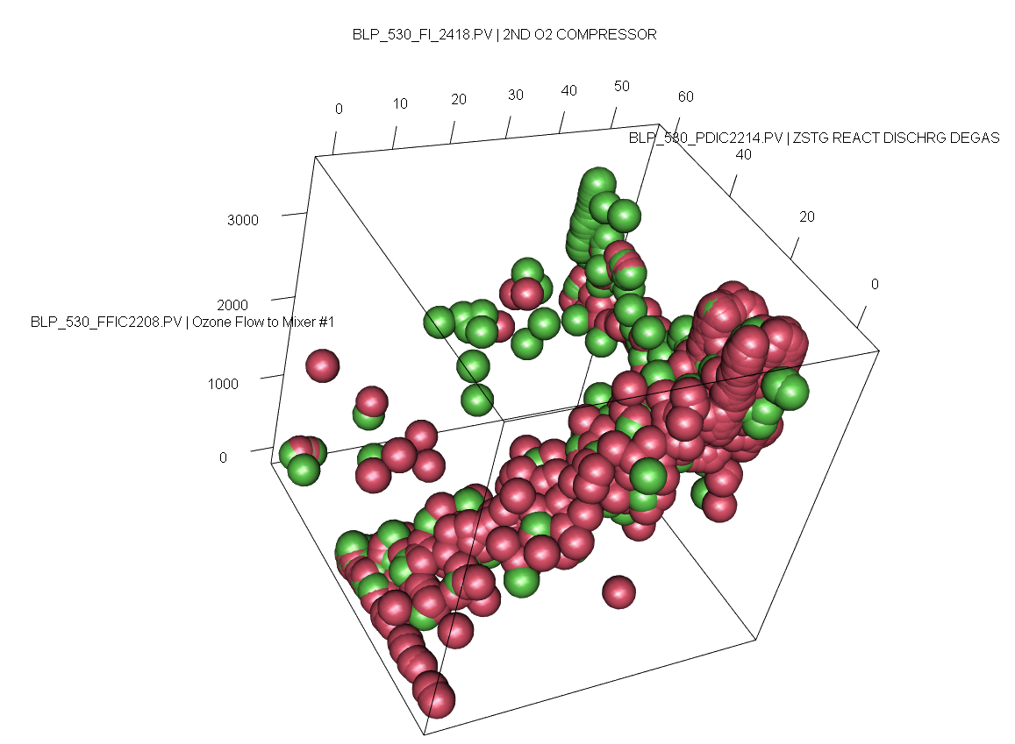
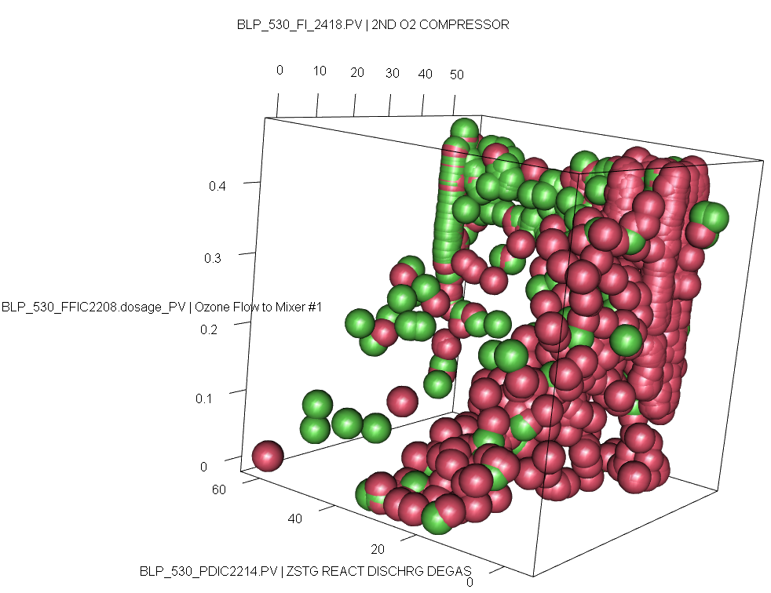
3D visualizations

Slide 18
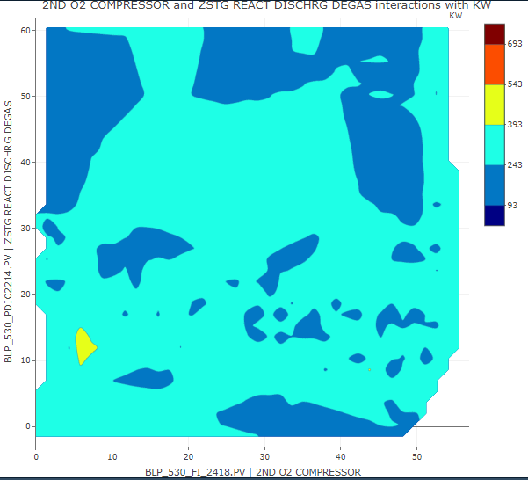
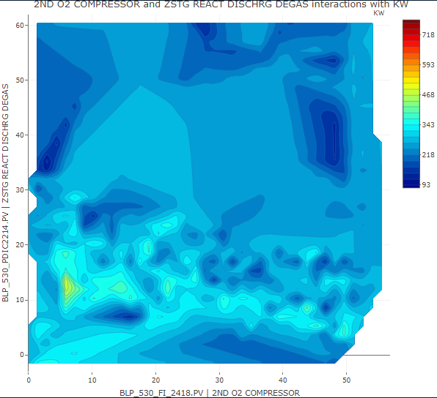
2D visualizations

Slide 19
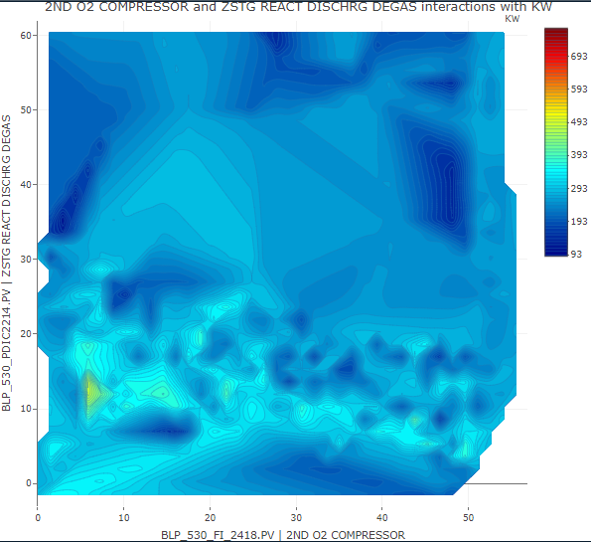
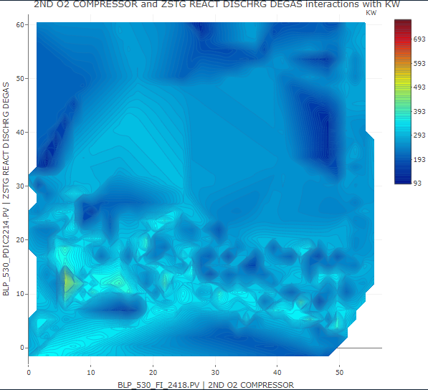
2D visualizations

Slide 20
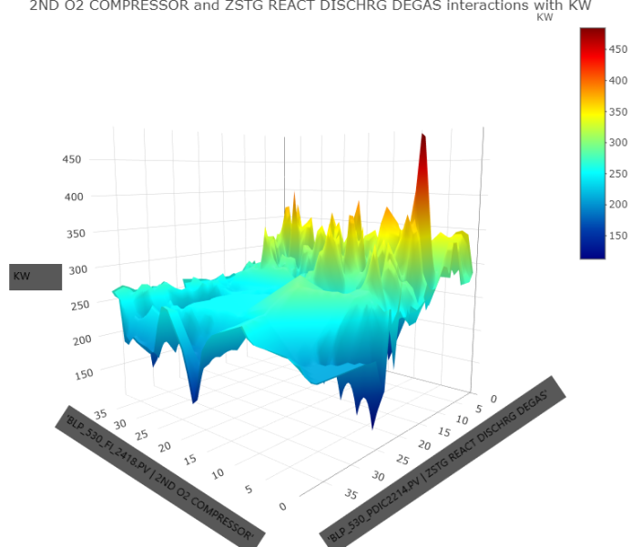
3D visualizations

Slide 21
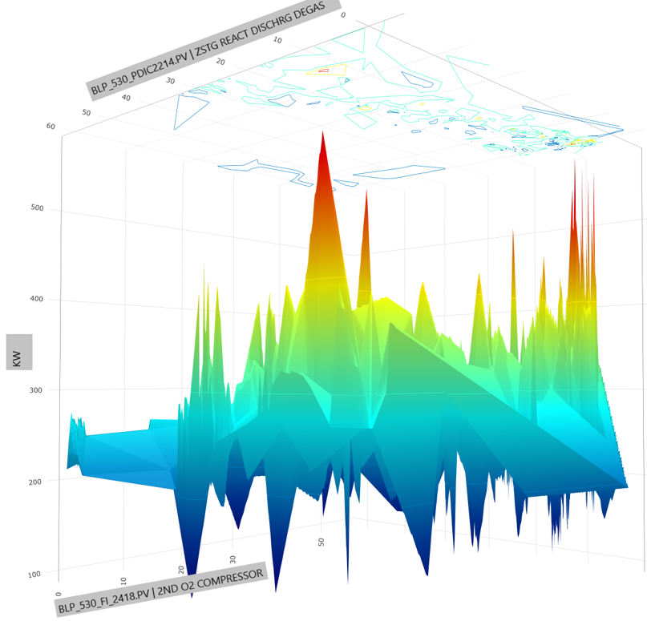
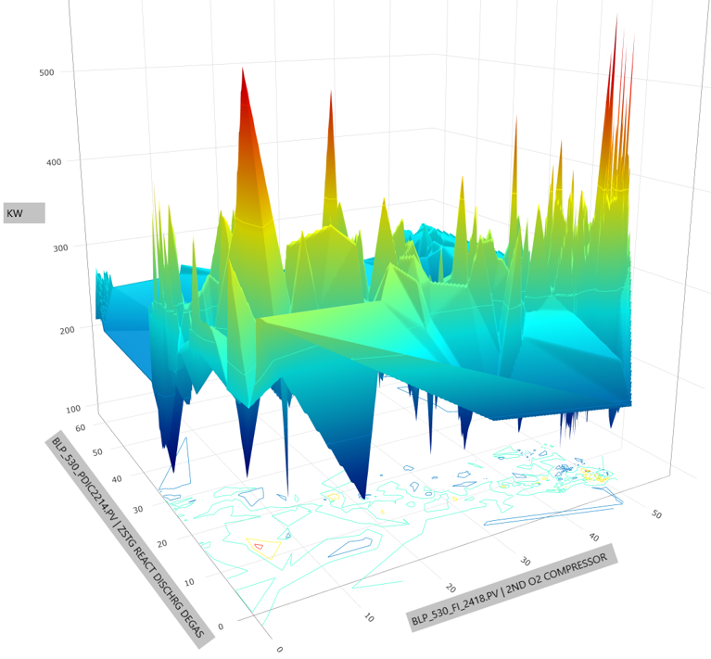
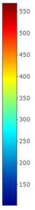
3D visualizations

Slide 22
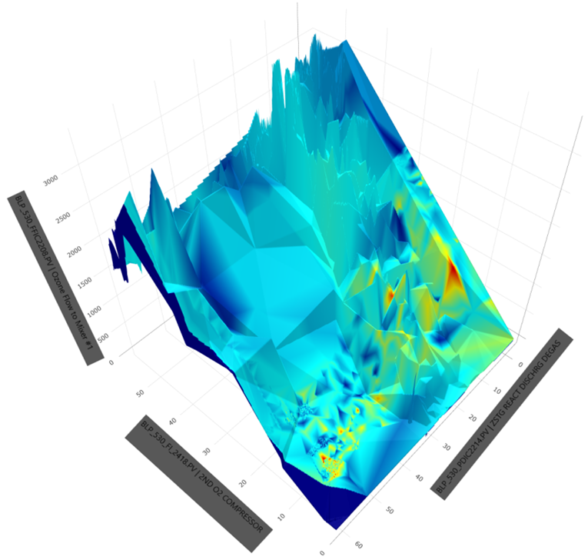
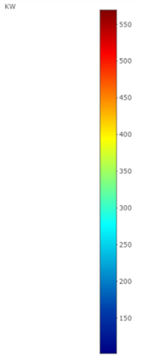
4D visualizations

Slide 23
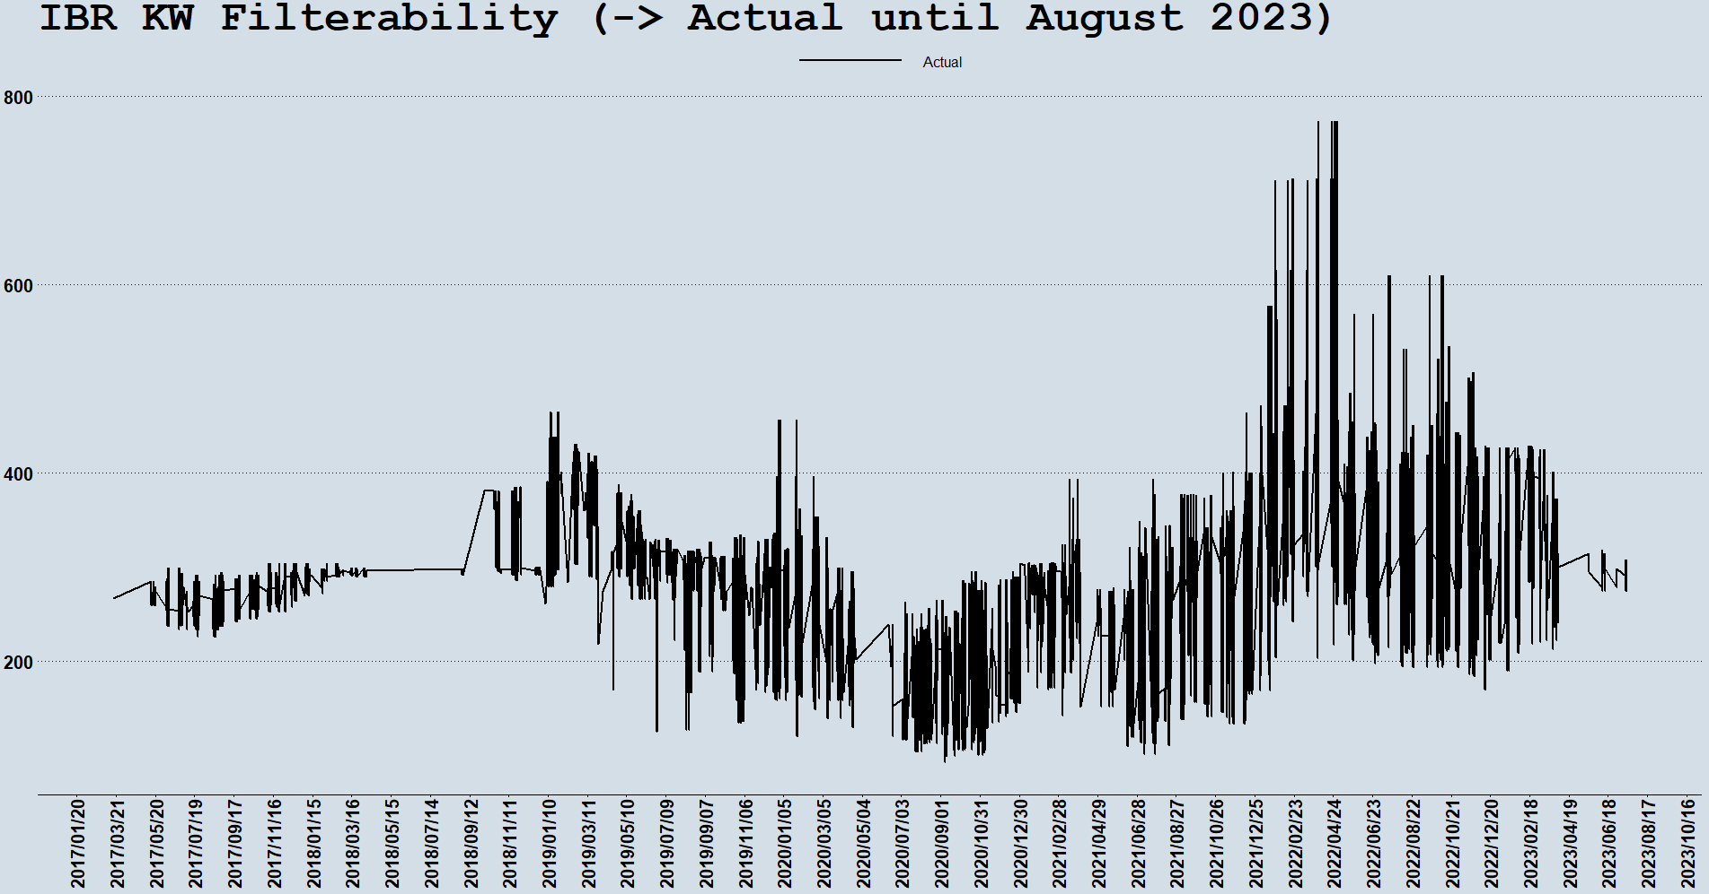
Actual

Slide 24
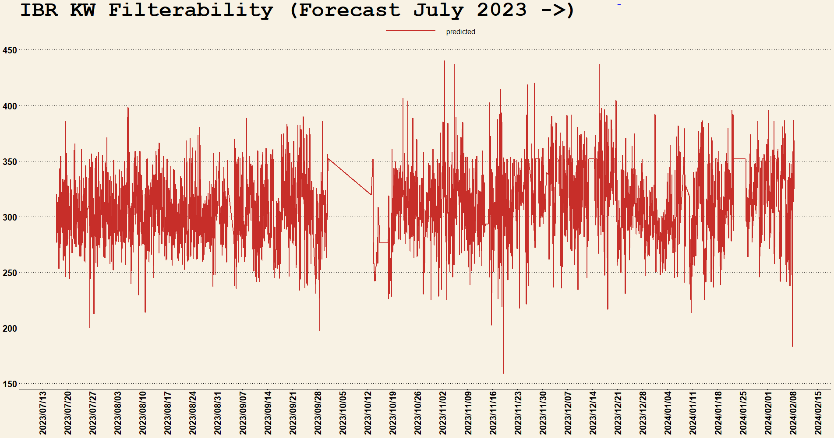
Forecast

Slide 25
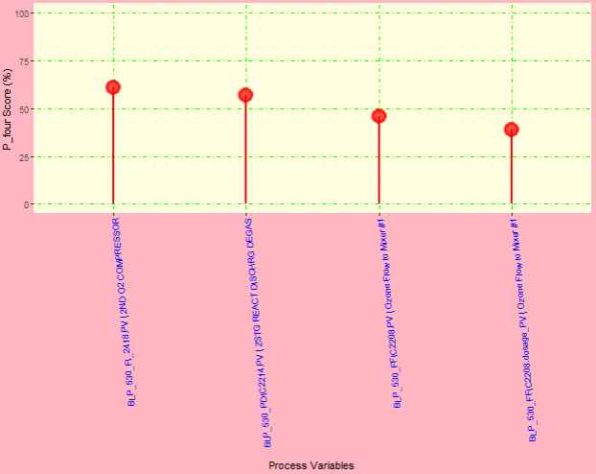
Important Variables

Slide 26
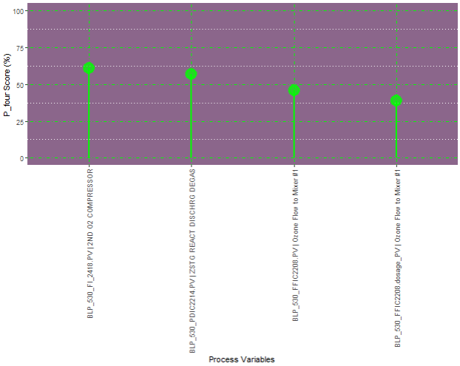
Important Variables

Slide 27
Key Takeaways
The desired levels of IBR KW Filterability values in this study are Loop 1: < 257.6 KW & Loop 2: < 154.3 KW
This analysis was restricted to only four (4) predictors:
BLP_530_FI_2418.PV | 2ND O2 COMPRESSOR,
BLP_530_PDIC2214.PV | ZSTG REACT DISCHRG DEGAS,
BLP_530_FFIC2208.PV | Ozone Flow to Mixer #1,
BLP_530_FFIC2208.dosage_PV | Ozone Flow to Mixer #1.
The number of observations were nearly tripled (12000 → 33000)
The continuous variables were discretized using the `cluster` method.
The Predicted vs. Actual plot show that the model has a high predictive accuracy (88.03 %).
The IBR KW values are forecasted to be mostly below 350 KW and generally above 200 KW so far in 2024.
A table of Recommended Settings is provided.

